Slide 1
Biodiversity in US National Parks
By : Aksh Thakkar and Gayathri Dornadula

Slide 2
Project Objective
To analyze plant and animal species across various National Parks in the US.
Discover insights on species through visualizations to examine parameters like seasonality, nativeness, occurrence and abundance.
The derived insights will have the below applications:
Guidelines for a visitor to a National Park.
Research Scientists can use the insights to analyze biodiversity across the US.
Appropriate Conservation Laws can be implemented in the Parks to protect the endangered species.

Slide 3

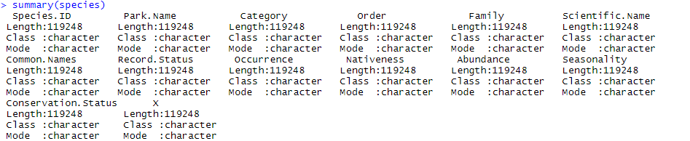
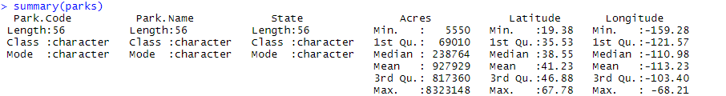
Data Description
Species - 119248 obs. of 14 variables
Parks – 56 obs. Of 6 variables

Slide 4
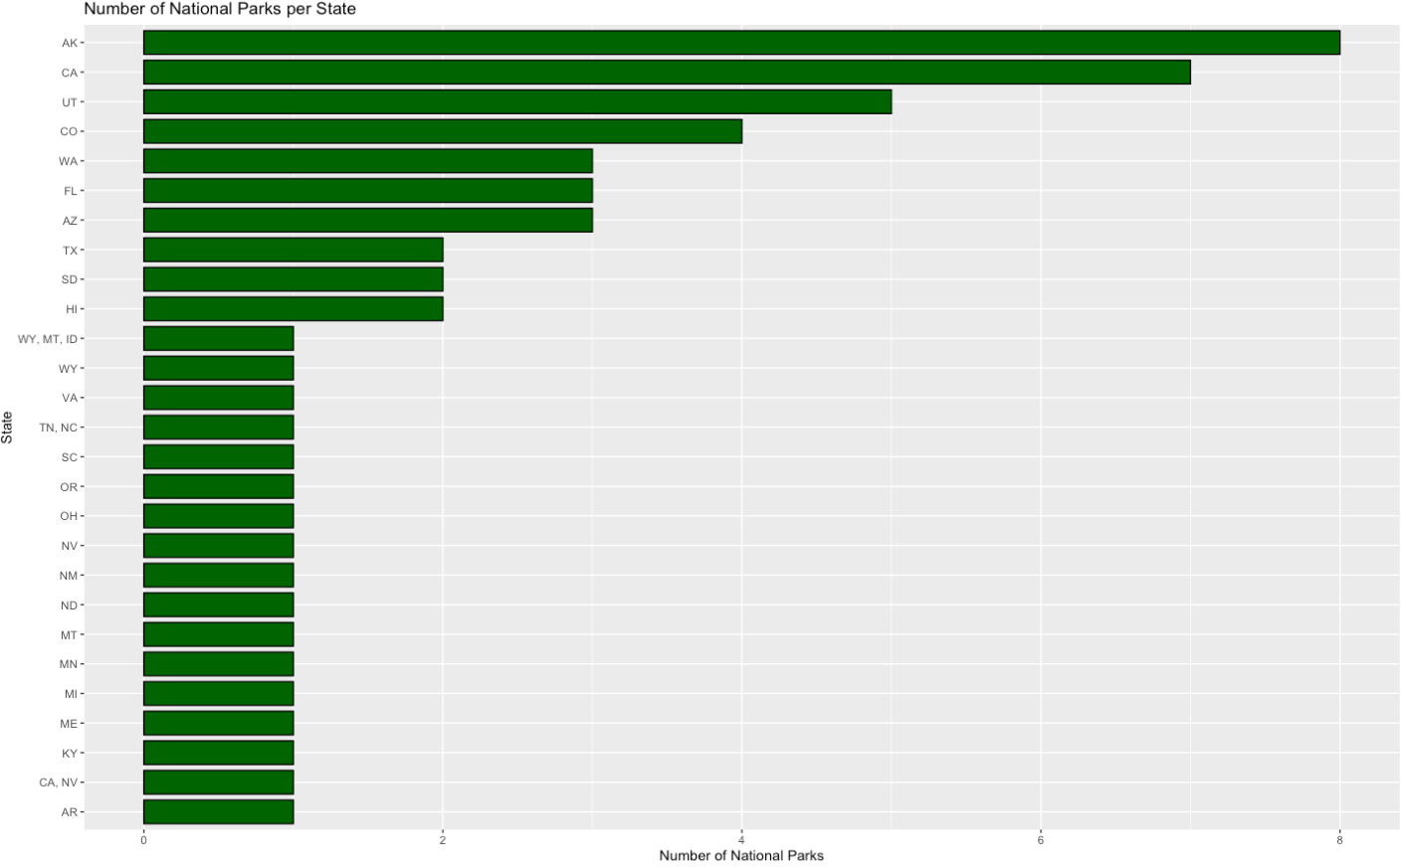
Count of National Parks by State

Slide 5
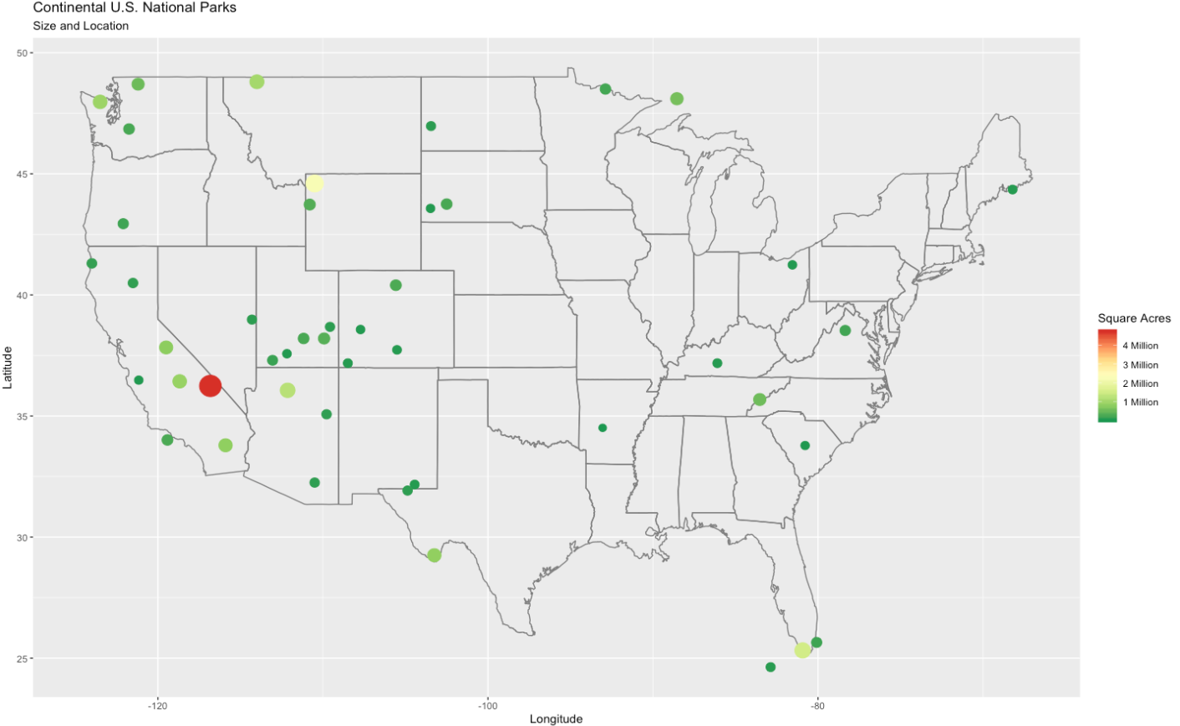
Size and Location of National Parks

Slide 6
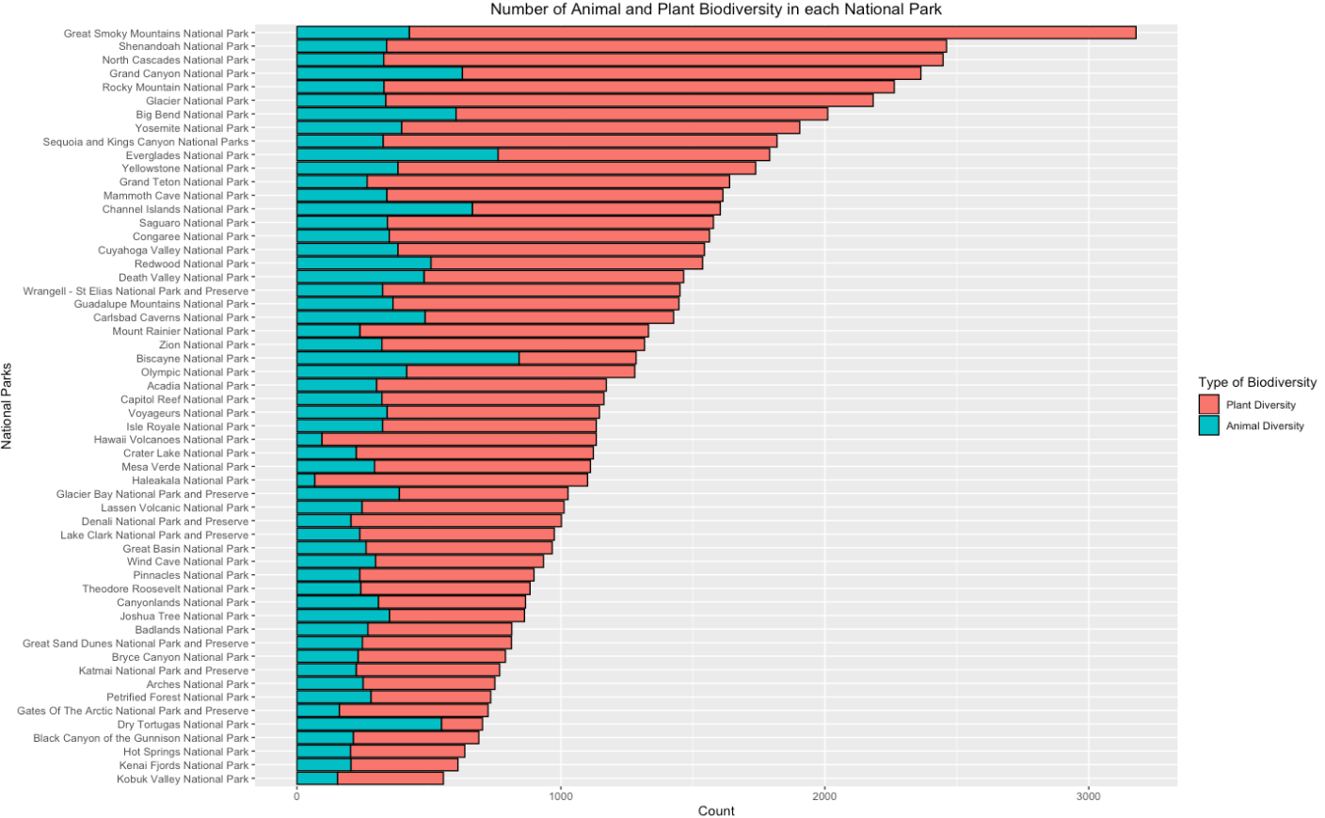
Biodiversity Distribution across Parks

Slide 7
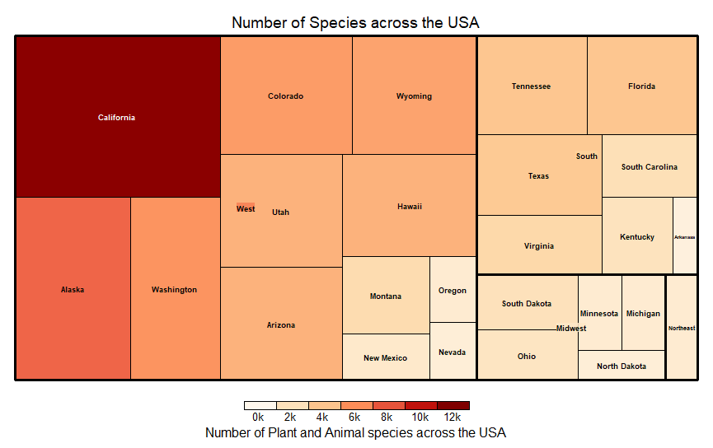
Distribution of Species across Regions

Slide 8
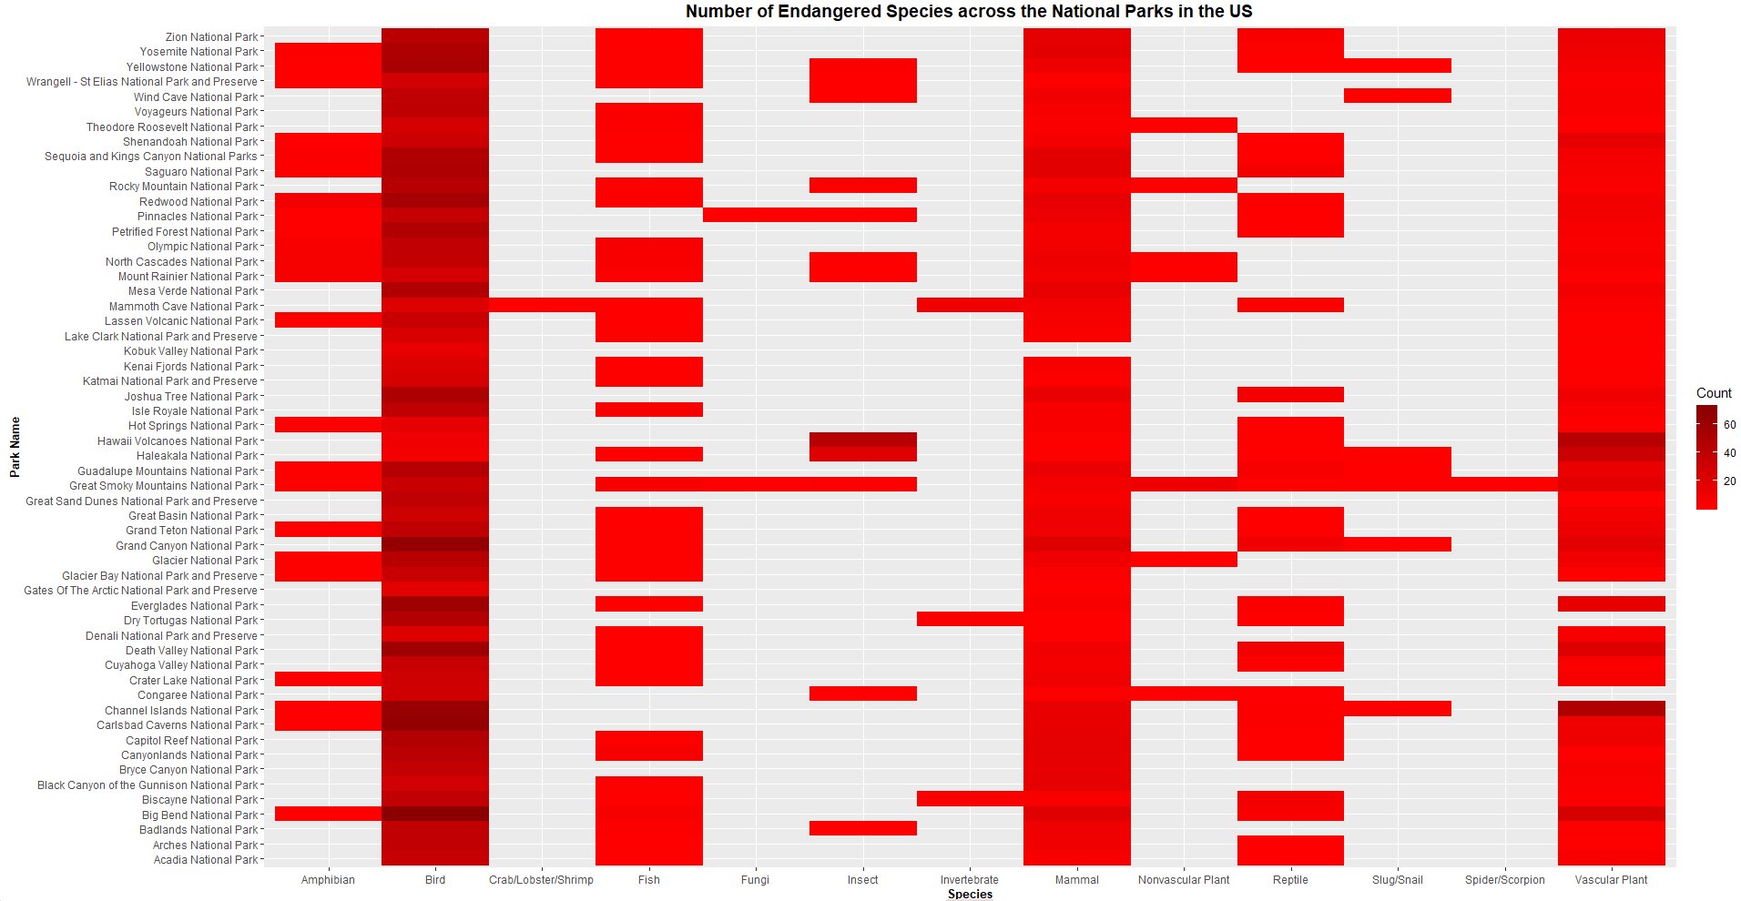

Endangered Species Analysis

Slide 9
Future Steps
Analyze common species in each National Park.
Derive insights about migration of species.
Examine how richness in biodiversity varies with latitude.
Is there a relationship between the Park Size and biodiversity?
Explore why there is good biodiversity in some parks than the others using related Datasets in the public domain.

Slide 10
Incorporate to our Portfolio
All the inferences drawn from this project can be mentioned in our portfolio.
Explored our creative and analyzation skills through visualization techniques.
Built knowledge about the National Parks and the kind of species that can be found across the US.
Lastly, decided on the National Park that we would like to visit!

